Slide 1

ICT406 IT Professional Environment: Law, Ethics and Privacy Privacy Law
Dr. Abbass Ghanbary
a.ghanbary@aapoly.edu.au

Slide 2
Lecture Outline
Information age and privacy
Privacy issues and protection
World law and Australian Privacy ACT
Real Scenario of Privacy
Ethics of privacy

Slide 3
Information Age
Collection of more data by organization
Share data across various gadgets and networks
This has general impact on:
Who has the authority to define the level of exposure of this data.
What is classified as sensitive data.
In the cyberworld, who are the people who pay the final price.
Notes:
Many new database developers suffer from the ‘spreadsheet syndrome’, creating as few tables as possible, often just a single table. They place dozens of columns in their table, to try and cover every possible piece of data, even though they often leave most columns unfilled for a given row.
By contrast database normalization aims to store the smallest amount of info possible in each table, leaving no columns that are filled for just a few of the rows. In fact, in a properly normalized table there should be very few empty(NULL) fields.
This is accomplished by restructuring the data into multiple tables, with each table containing a subset of the information.
Database normalization is the process of modifying your schema so that its tables conform to a progressive series of normal forms.

Slide 4
Information Privacy Issues
Data Ownership
Data Risk
Data Protection
Data Loss
Notes:
Many new database developers suffer from the ‘spreadsheet syndrome’, creating as few tables as possible, often just a single table. They place dozens of columns in their table, to try and cover every possible piece of data, even though they often leave most columns unfilled for a given row.
By contrast database normalization aims to store the smallest amount of info possible in each table, leaving no columns that are filled for just a few of the rows. In fact, in a properly normalized table there should be very few empty(NULL) fields.
This is accomplished by restructuring the data into multiple tables, with each table containing a subset of the information.
Database normalization is the process of modifying your schema so that its tables conform to a progressive series of normal forms.

Slide 5
Remedy for Privacy Issues
Collection of absolute required information by organsiation based on evaluating the need for this data.
Protecting and safeguarding the data in a secure environment and share if authorised and necessary.
Individual permission to correct their own related data and request removal authroised by law.
Organisation must take full responsibility for the breach and held responsible for their action.
Notes:
And hey, odds are you can change more than one column, and you may have more than a million rows.

Slide 6
Privacy Law
As discussed earlier, the law is different by regions and countries. This is regarding:
Exposing information by individual to an organization.
Authorising the use of this information.
Requesting information about how this information is protected.
Knowing who will see, change, delete or access this information.
And, how the law id enforced protecting the information.

Slide 7
Privacy Law in Australia
Privacy Act 1988 was introduced to promote and protect the privacy of individuals and to regulate how Australian Government agencies and organisations with an annual turnover of more than $3 million, and some other organisations, handle personal information.
https://www.oaic.gov.au/privacy/privacy-legislation/the-privacy-act
The Freedom of Information Act 1982 (FOI Act) gives you the right to request access to government-held information. This includes information they hold about you or about government policies and decisions.
https://www.oaic.gov.au/freedom-of-information

Slide 8
Reality
People hiding their individuality and leave of the record. In many countries, this would be easily achievable.
People using many different identity for different objectives.
Identity theft or digital representation of the individual.
Having authentication for ensuring accuracy, quality and integrity of the data. Is this what can be done?

Slide 9
Threats to Privacy
What do we do with the data:
Artificial Intelligence (Sharing Information)
Data Analytics
Online shopping
Online banking
Personal tracking software (Google Maps.,,..)
Registering on various website (Advertisements, prizes…)
Receiving cookies
Spyware
Communication interceptions
Face recognition softwares
And,……

Slide 10
Required Security Framework
Lawfulness, fairness, and transparency: Fair use and process of personal data.
Purpose limitation: Use for specified purpose.
Data minimisation: Usage of minimum data for that purpose.
Accuracy: Accurate and reengineered process in place.
Storage limitation: Keeping the data for no longer than necessary.
Security: Personal data is processes in a secure and appropriate manner.
Accountability; Having governance privacy in place
https://www.youtube.com/watch?v=NcHSD3fWJiQ

Slide 11
Privacy and Ethics
Unethical junk email.
Sale of personal information.
Cookies (saved on your hardware).
Audit logs (registering all your actions on a specific websites).
Cybercrime, cybertheft, identity theft, intellectual property theft.
Digital divide (information poor and information rich).

Slide 12
Laws and Technology
Technology allows controls on communications, location, social surfing and all our lifestyle but Privacy is about human rights.
Law needs to ensure protecting the human rights not allowing other people to cause harm “Managing Human Boundaries”.

Slide 13
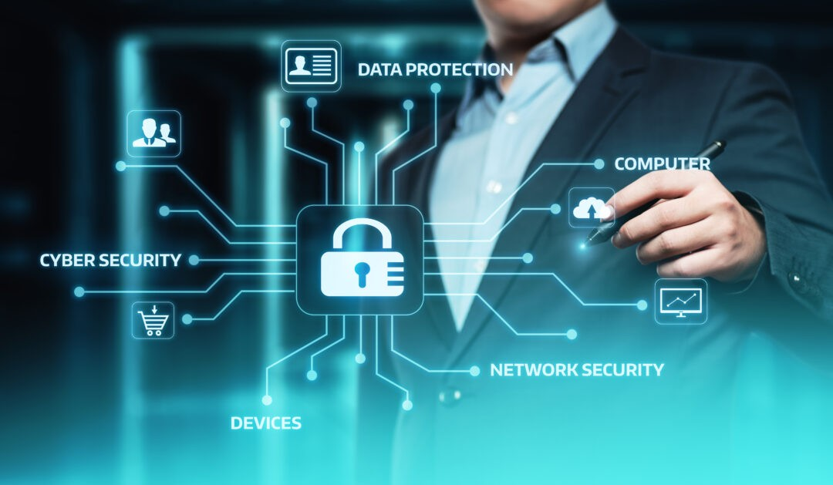
https://www.linkedin.com/pulse/technology-companies-responsibility-safeguard-user-data-dennis-mutahi/

Slide 14
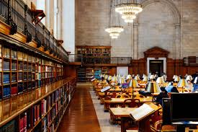
Reading Materials

Slide 15
Articles and Books
Milne, G. (2015). Digital Privacy in the Marketplace. Business Expert Press. ISBN: 9781606498491
Klosek. J. (2006). The War on Privacy. Praeger. ISBN: 9780313056420
Nissenbaum, H. (2009). Privacy in Context Technology, Policy, and the Integrity of Social Life. Stanford Law Books. ISBN: 9780804772891
Elliot, D. & Soifer, E. (2022). AI technologies, Privacy and Security. https://www.frontiersin.org/articles/10.3389/frai.2022.826737/full
Belanger, F. & Crossler, R. E. (2011). Privacy in Digital Age: Review of Information Privacy Research in Information Systems. MIS Quarterly. Vol. 35, No. 4 (December 2011), pp. 1017-1041 (25 pages) Published By: Management Information Systems Research Center, University of Minnesota

